Slide 1
Advanced Manufacturing of Electronics
for Space
Dr Rita Palumbo
5th SPACE PASSIVE COMPONENT DAYS - SPCD 2024
ESA-TECED-HO-2024-002869
TEC-ED ESA/ECSAT
17/10/2024

Slide 2
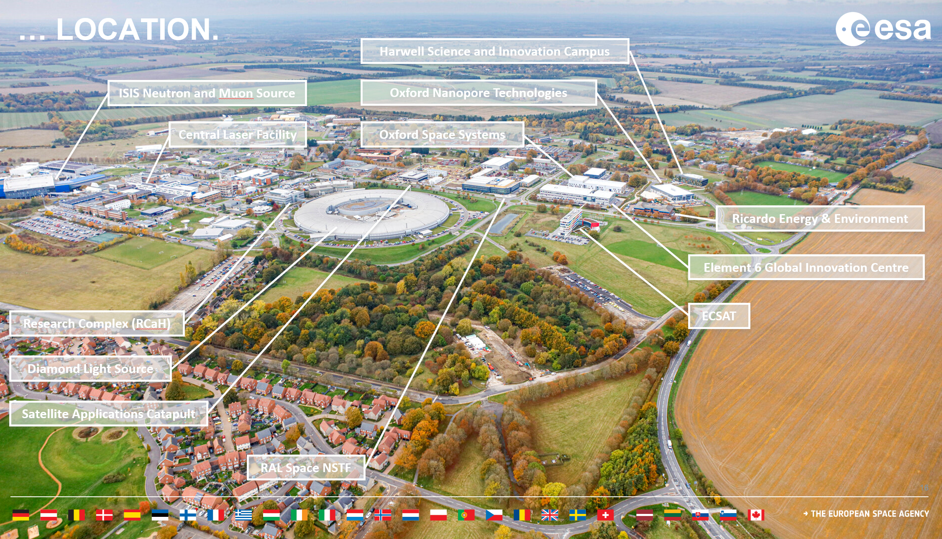

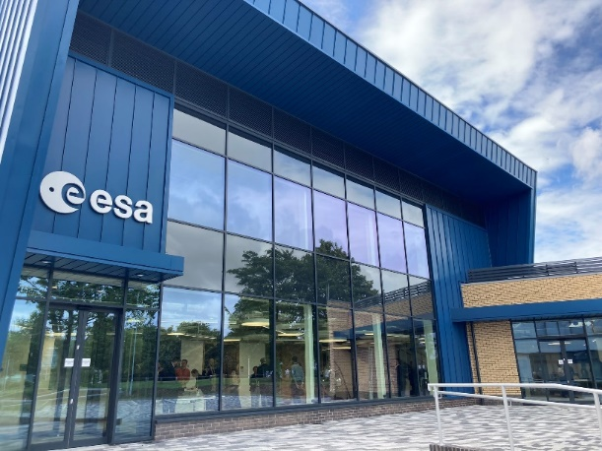
ESA European Centre for Space Applications and Telecommunications (ECSAT), Harwell Campus
ESA ECSAT
Notes:
Research Clusters:
Space Cluster
Quantum Cluster
Energy Tech Cluster
Health Tech Cluster
High-Tech Commercialisation Ecosystem
200 Organisations (600 in 10 years)
120 Start-ups & Scale-ups
Business Incubators

Slide 3

OUTLINE
Introduction to AME
ESA Vision for AME
Technology Gaps
Roadmap
GSTP Compendium
Conclusions
01
04
02
05
03
06

Slide 4
OUTLINE
Introduction to AME
ESA Vision for AME
Technology Gaps
Roadmap
GSTP Compendium
Conclusions
01
04
02
05
03
06

Slide 5
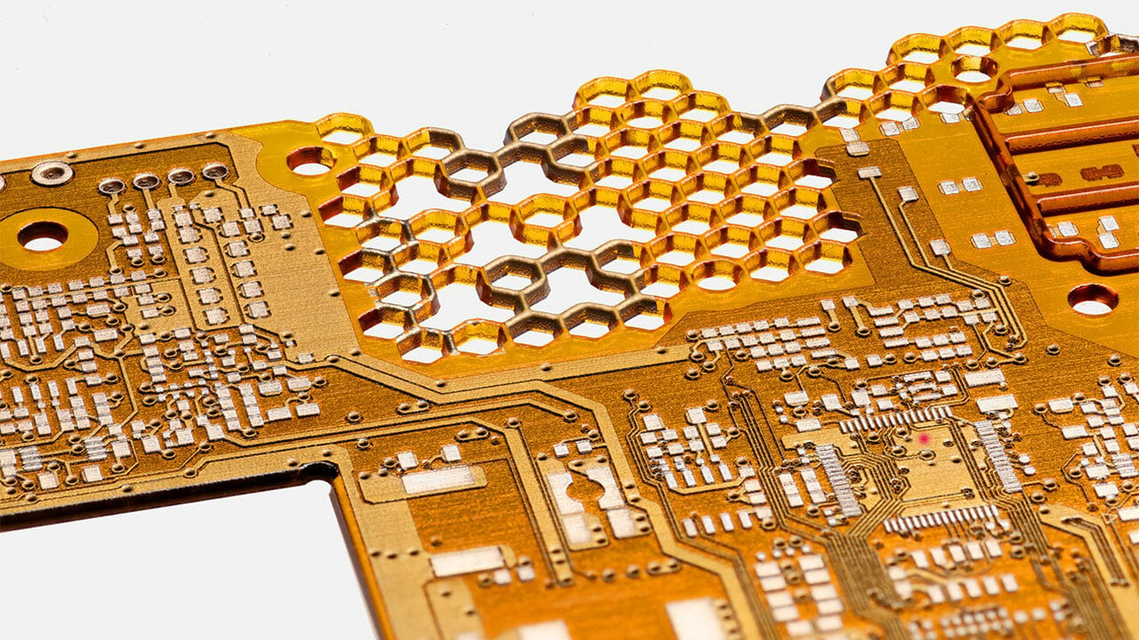
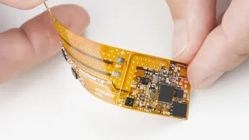

Advanced Manufacturing of Electronics (AME)
Cutting-edge technologies and processes used to manufacture electronics and components offering significant improvements in weight, miniaturization, customization, procurement time, technologies development and adoption, digital manufacturing, sustainability, and cost efficiency.
Nano Dimension
AME covers areas like 3D printing of electronics, hybrid electronics, flexible electronics, and novel materials for components and circuit boards, reshaping how electronics are designed, produced, and integrated into systems.
VTT

Slide 6
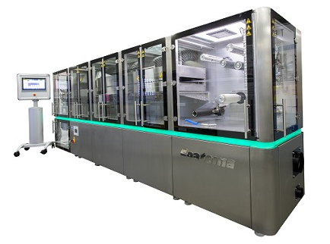
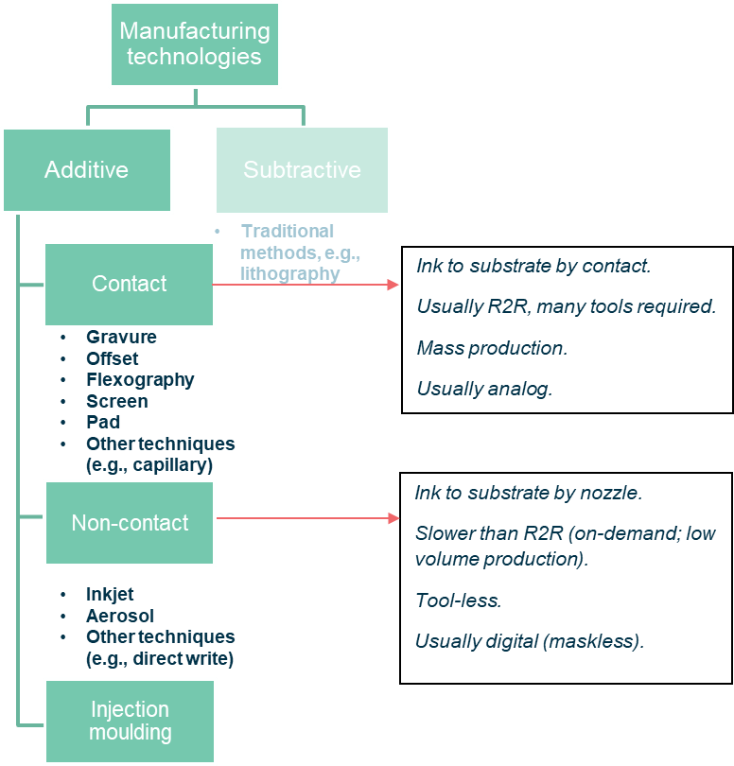
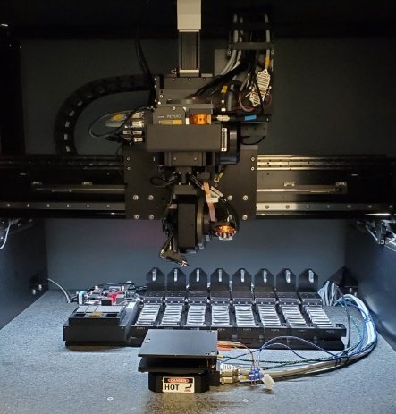
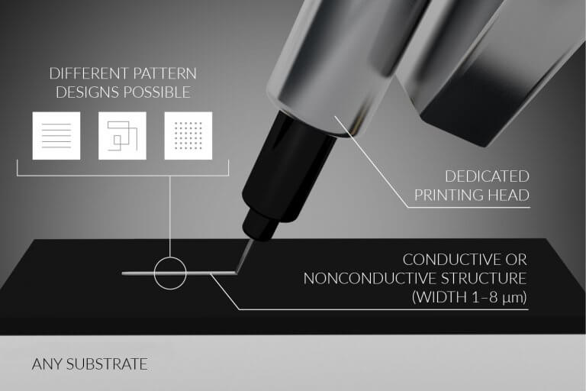
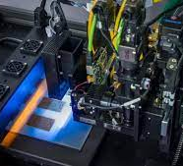
Advanced Manufacturing of Electronics (AME)
Coatema Coating Machinery GmbH
nScrypt
XTPL
Nano Dimension DF IV

Slide 7
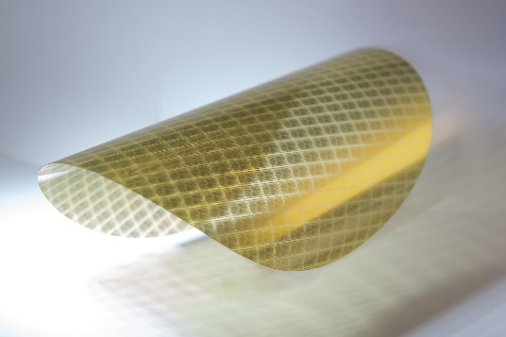

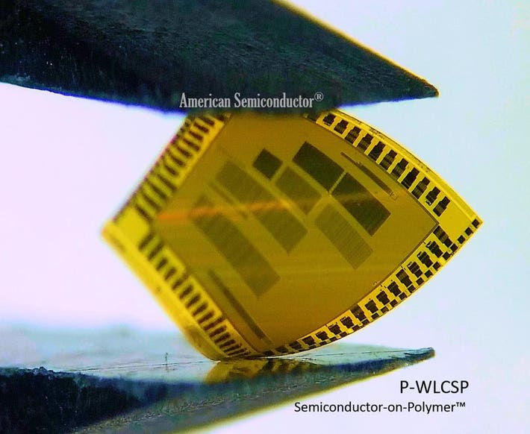

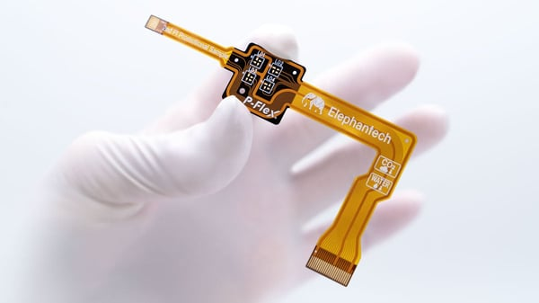
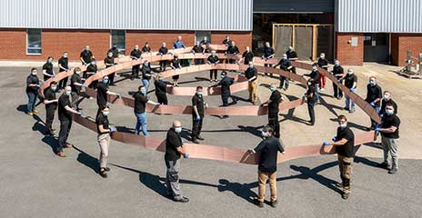
Advanced Manufacturing of Electronics (AME)
 | PRINTED | NOT PRINTED
FLEXIBLE | Conductive ink onto flexible substrates additively | Conductive layer on flexible substrate (e.g. removed via etching)
RIGID | Conductive ink onto rigid substrates additively or multi-nozzle 3D printing | Established PCB and electronics manufacturing.
© Pragmatic
© Shutterstock/KPixMining
© American Semiconductor
© Holst Centre
© Elephantec
© TrackWise | 72m long, multi-layer flex circuit
Notes:
Not printed and flex – examples: Pragmatic, Trackwise

Slide 8
OUTLINE
Intro to AME
ESA Vision for AME
Technology Gaps
Roadmap
GSTP Compendium
Conclusions
01
04
02
05
03
06

Slide 9
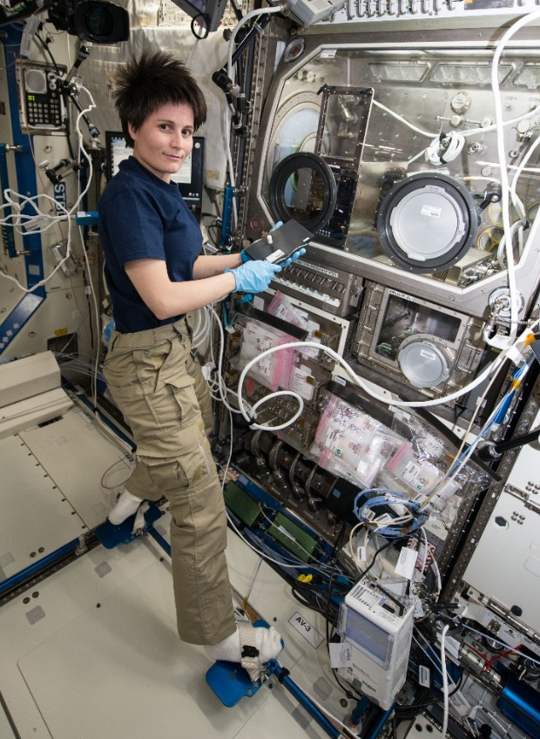
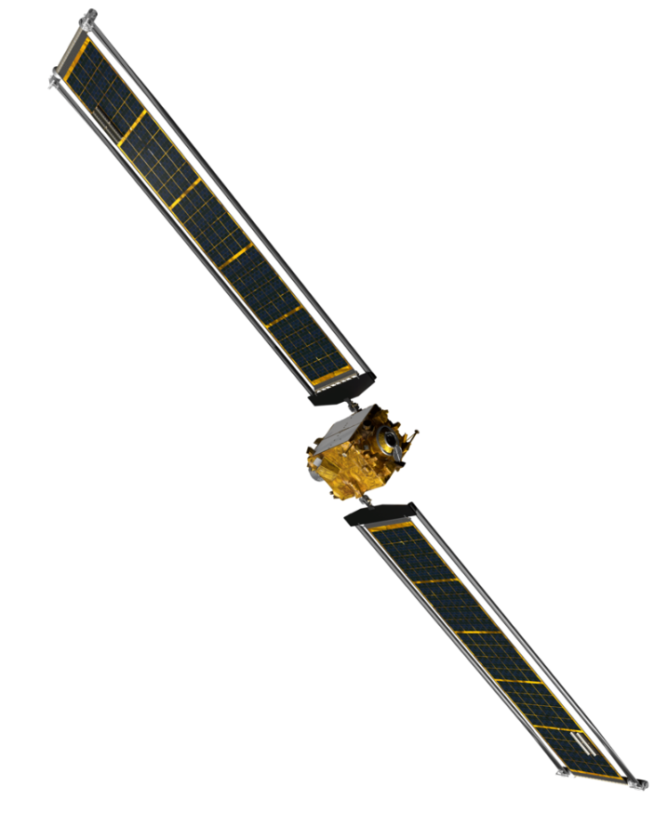
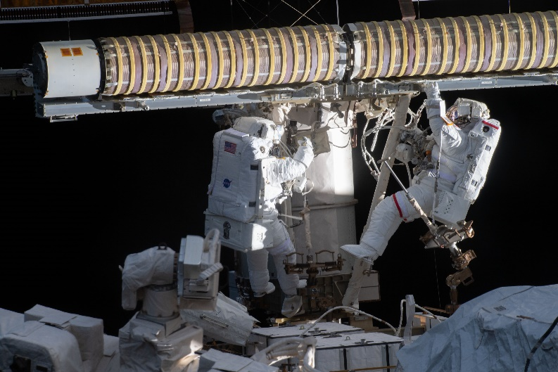
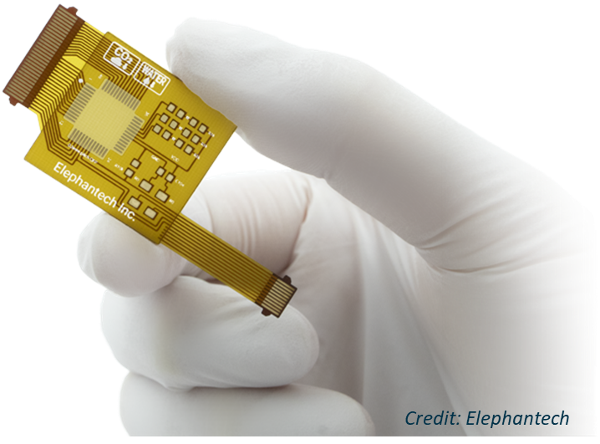
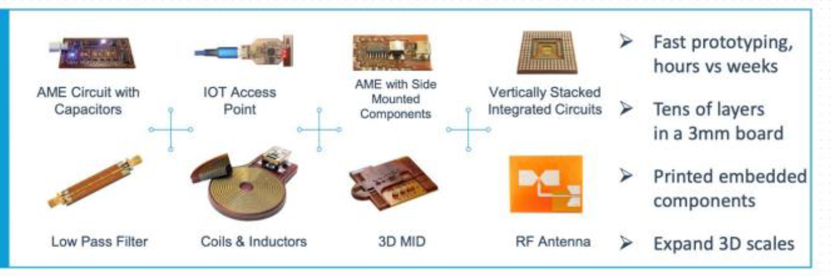
TEC-ED Vision for AME
Introduce Advanced Manufactured Electronics (AME) to space
Building on TEC-M work on Advanced Manufacturing
Facilitate the industrialization of AME techniques and the development of a
European, local, one-stop-shop supply chain for
sustainable, agile, and digital manufacturing of electronics and components.
Digital Manufacturing
On-demand Production
European Supply Chain
Cost Reduction
Weight/Volume Optimization
Sustainability
Miniaturization
Simpler Packaging and Monolithic Integration
©NASA
©Elephantec
©Nano Dimension
Installation of roll-out solar arrays on the ISS - ©NASA/ESA

Slide 10
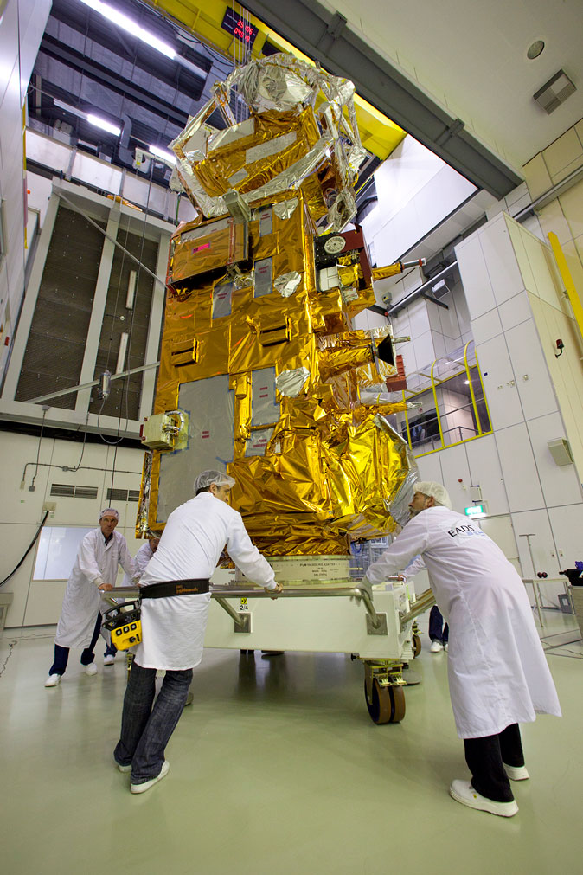

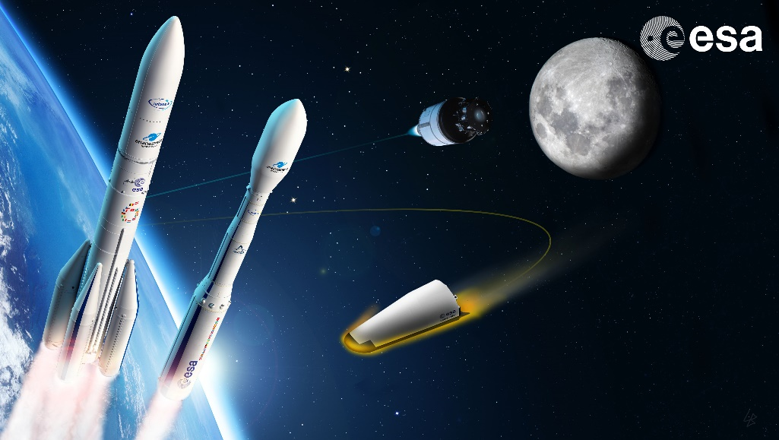
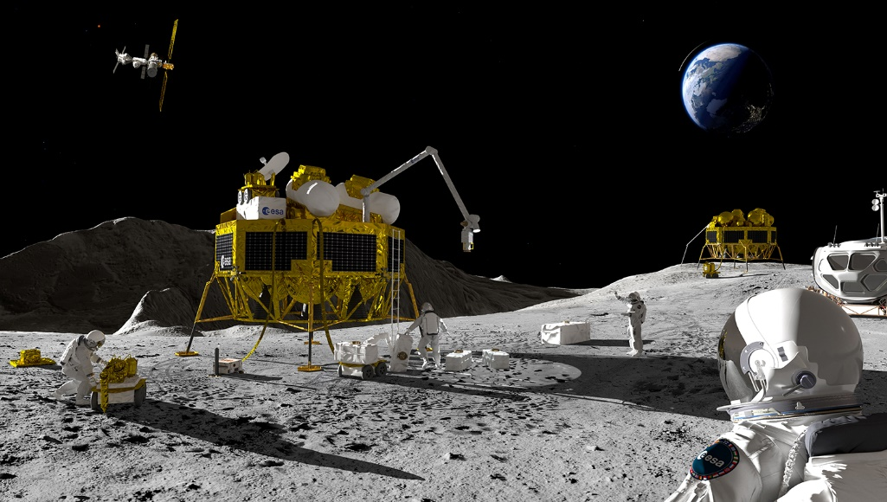
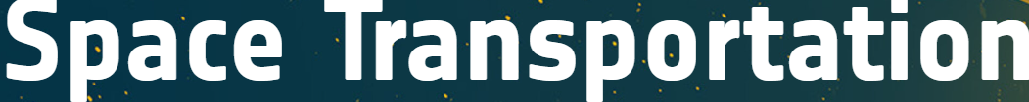
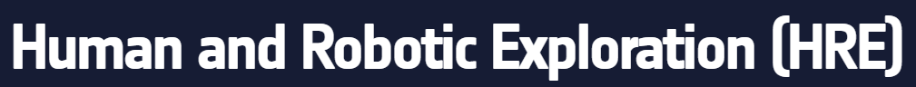

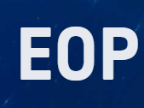


Introduce Advanced Manufactured Electronics (AME) to space.
The strategy is holistic and across directorates, to have a coordinated and shared roadmap.
© Elephantec

Slide 11
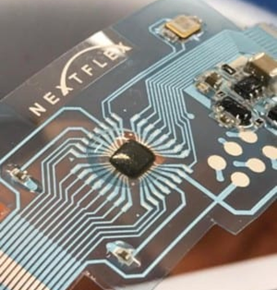
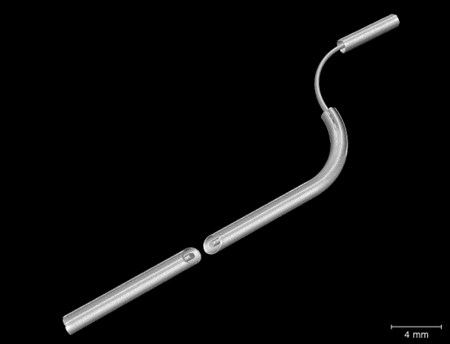
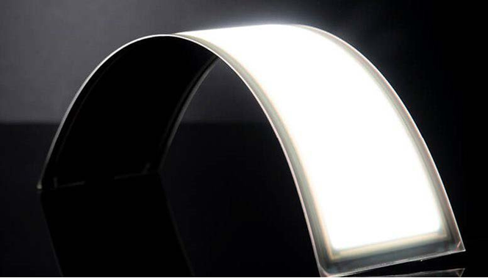
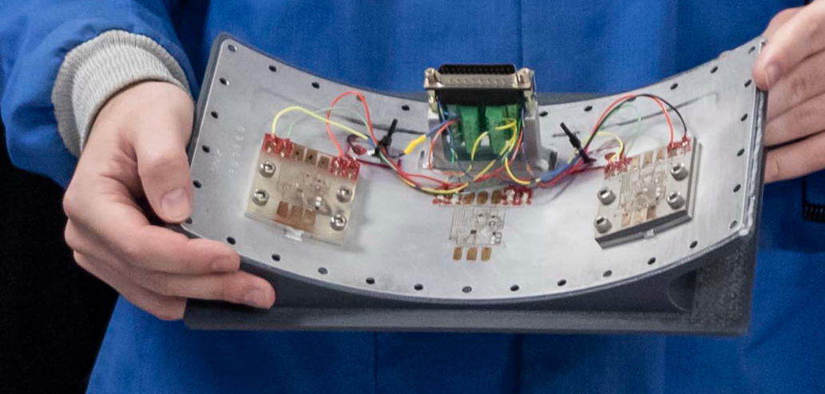
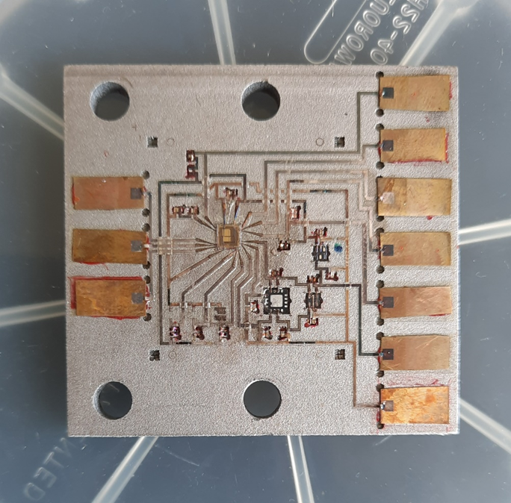
MOTIVATIONS FOR AME FOR SPACE
AME offers game-changing advantages for the high-variety/low-volume space industry and for prototyping:
Digital manufacturing supports ESA digital transformation of the design process (integration with AI and digital twins).
On-demand, rapid, agile manufacturing (procurement from 6-12 months to 24 hours) allows to quickly react to market needs
Possibility to develop an independent, European supply chain for electronics and components
Up to 10x costs reduction
Up to 70-90% weight reduction
Up to 86% reduction in environmental impact
Access to z dimension → unconventional 3D configurations, any shape, any substrate,
miniaturization, embedding electronic functionality into the structure (e.g., walls of a satellite)
Simpler packaging and monolithic integration potentially reduce failures in space.
L3Harris Investigates 3D Printed Materials for Satellite Manufacturing.
Image courtesy of NASA's Glenn Research Center
Hybrid flexible Arduino.
© NextFlex
X-Ray scan of Coaxial cable 3D printed with Nano Dimension Dragon Fly IV.
Flexible white OLEDs for solid-state lighting.
© OLEDWorks
Hybrid printed circuits tested at the edge of space by NASA engineers in July 2023. © NASA

Slide 12
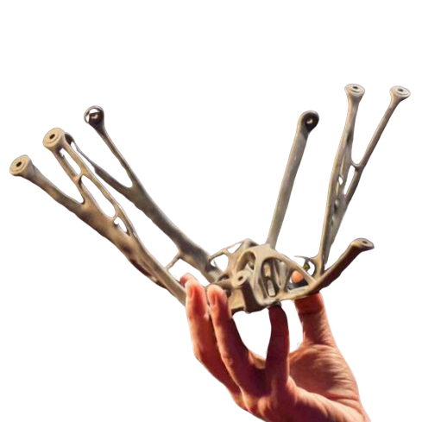
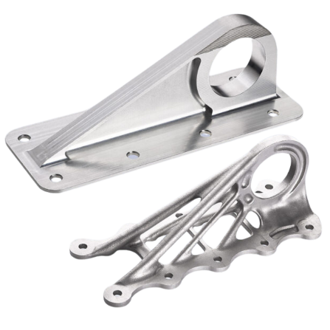


INNOVATIVE CONCEPTS
“The biggest mistake you can do with 3D printing is duplicating an existing design”
~ Tommaso Ghidini, H/Mechanical Department • TEC-M, TEDxESA 2015
And from a structural point of view, it adds material only where needed
Nature is additive!

Slide 13
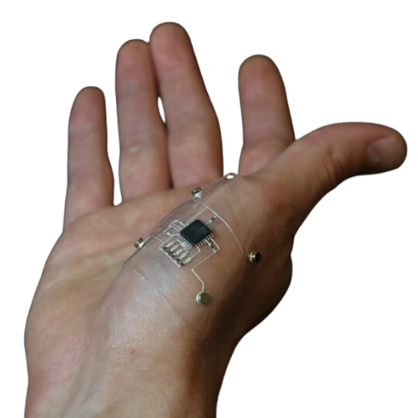
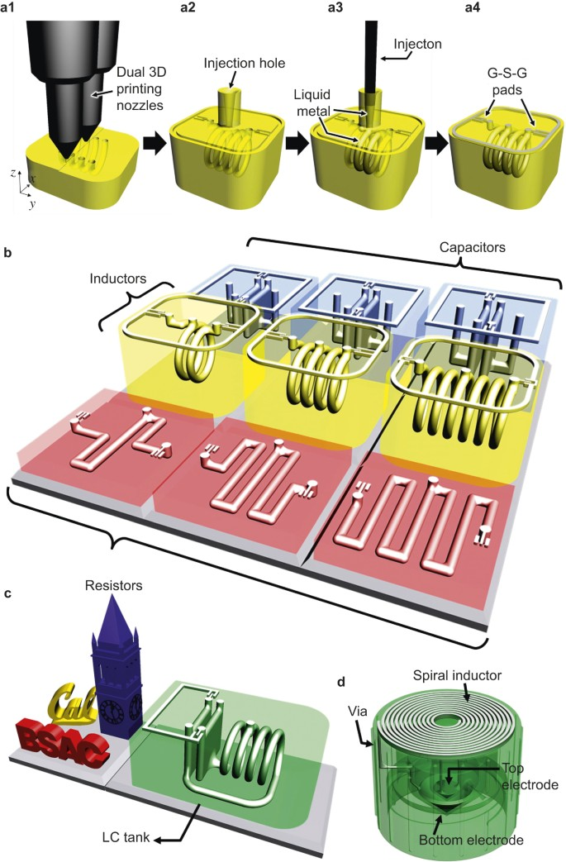
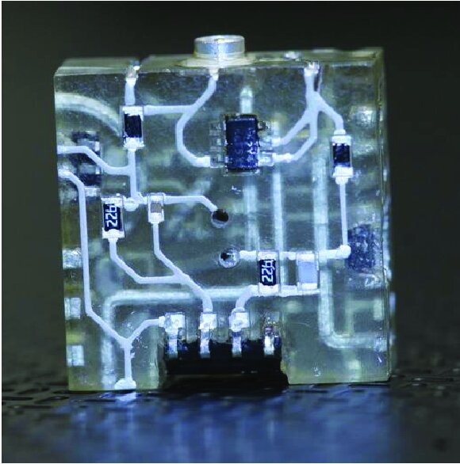
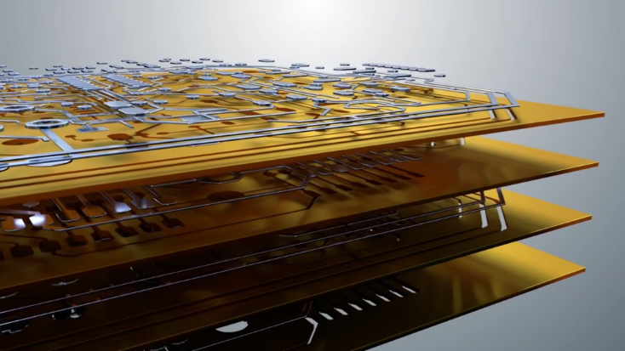
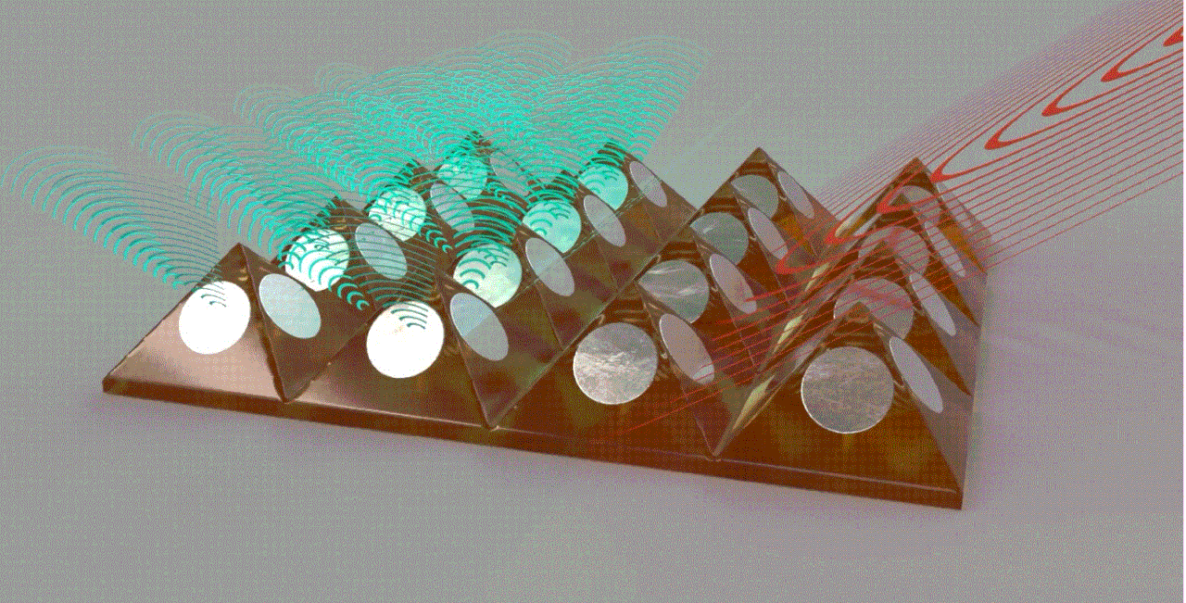
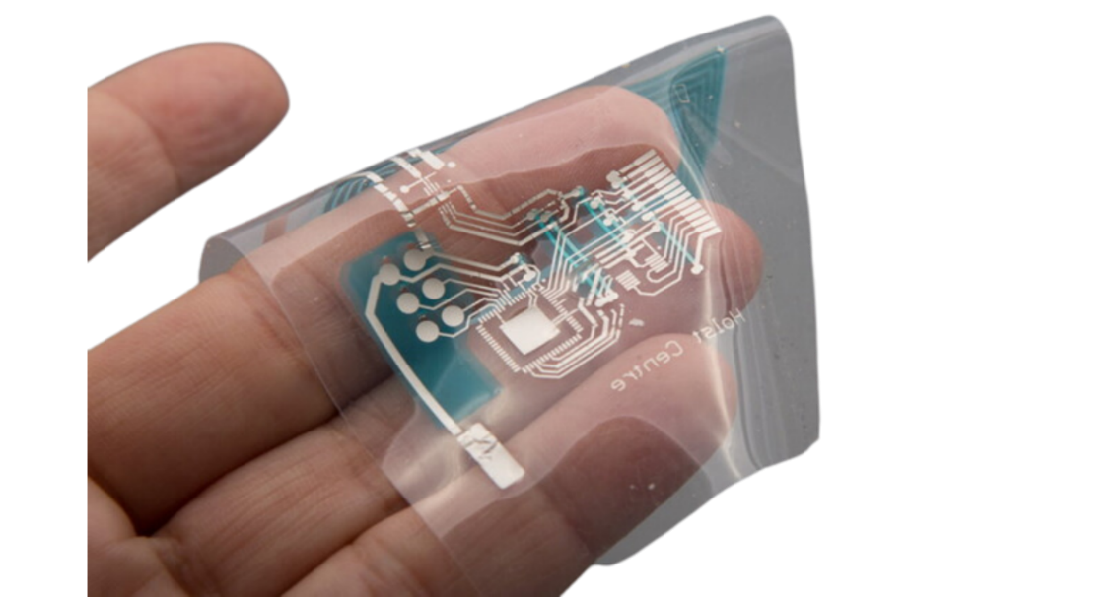
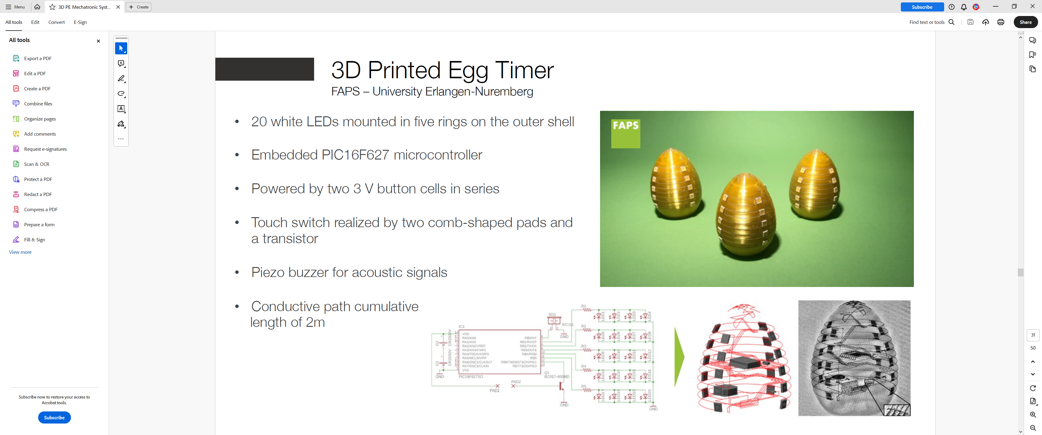
INNOVATIVE CONCEPTS
We need to learn to think in 3D also for electronics,
and develop new designs to make full use of the potentiality printing has to offer!
[3]
[1]
[4]
[5]
[2]
[1] Credit: Alex Valentine, Lori K. Sanders, Jennifer Lewis / Harvard University
[2] Demonstrator of 3D Printed Egg Timer | FAPS – University Erlangen-Nuremberg, Neotech
[3] Sphere phased array antenna – Nano Dimension
[4] 3D printed signal conditioning circuit. Eric Macdonald 2014
[5] Nano Dimension
©Holst Centre
Wu, SY., Yang, C., Hsu, W. et al. 3D-printed microelectronics for integrated circuitry and passive wireless sensors. Microsyst Nanoeng 1, 15013 (2015)

Slide 14

The pivot to AME is not easy
But the payoff can be enormous.

Slide 15

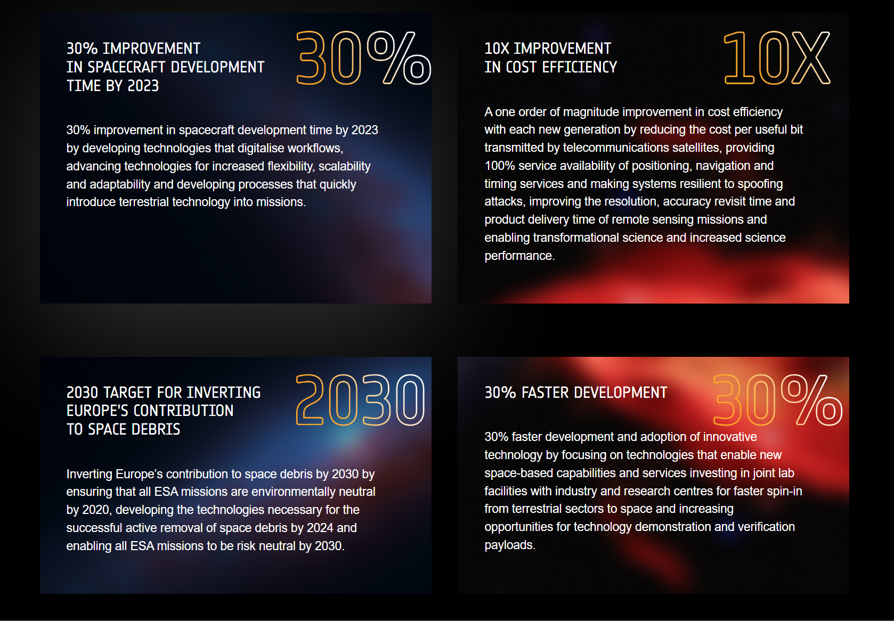

AME aligns with ESA’s Technology targets…
Notes:
Methods of Advanced Manufacturing of electronics stand out as a game-changing technology that can potentially revolutionize the development of space technologies and
help achieve the Agenda’s targets.
ESA Technology Strategy – Telecom technology needs identified include stowable and deployable antennas; flexible solar arrays, deployable radiators, lightweight harnesses; in the smart design and manufacturing: function tailored materials, embedded sensors, additive manufacturing. Overall, low cost and short time to market.

Slide 16


… and with ESA Green Agenda (EGA)
EGA mobilises all of ESA and the space sector to contribute to the climate neutrality of Europe. It will soon provide training for ESA engineers to introduce LCA and eco-design principles in all phases of mission design.
Notes:
The extensive use of electronics throughout the modern world has showcased the need to decarbonise the electronics industry. It is important to apply green production processes and innovations. The EU-funded REFORM project will help achieve this goal by addressing the whole electronics supply chain and reforming it to meet current green needs. The project will further develop environmentally benign electronic building blocks, utilising green materials that help reduce environmental strain, for use in electronics systems and methods for their efficient recovery and efficiency. Finally, REFORM will collaborate with stakeholders, academics and associations related to the industry to increase the efficiency and reach of the project.

Slide 17
OUTLINE
Intro to AME
ESA Vision for AME
Technology Gaps
Roadmap
GSTP Compendium
Conclusions
01
04
02
05
03
06

Slide 18
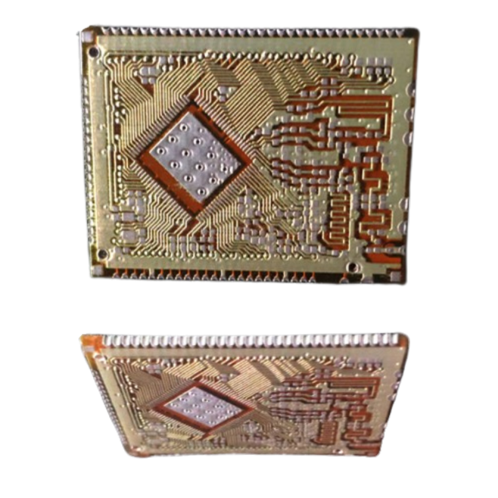
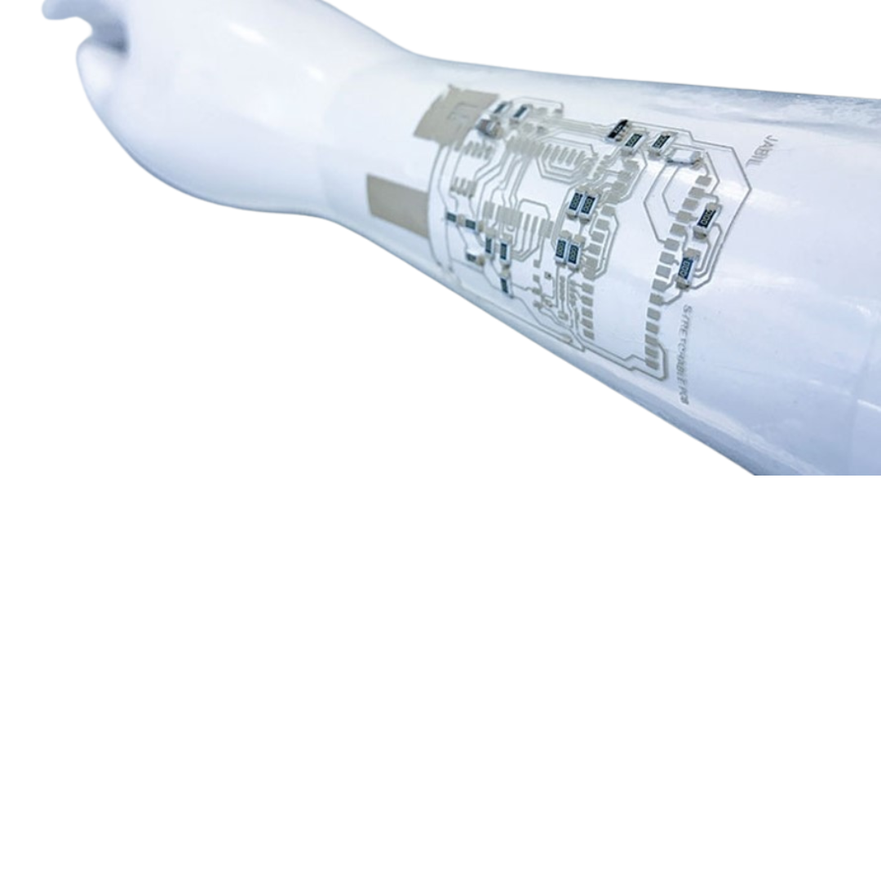
TECHNOLOGY GAPS
Accuracy and resolution – most traditional printing methods allow >10 um feature size.
Low mobility and device density (difficult to fabricate high-performance components).
Hybrid systems integrating AME with traditional electronics are the best solution.
High roughness can limit high-frequency RF applications.
Standards for reliability and repeatability are still under development.
No space heritage / space compatibility to be tested and developed.
Side mounting on PCBs, created by Nano Dimension DragonFly Pro
© American Semiconductor
Hybrid flexible Arduino.
© NextFlex
Photo courtesy of Jabil.

Slide 19
OUTLINE
Intro to AME
ESA Vision for AME
Technology Gaps
Roadmap
GSTP Compendium
Conclusions
01
04
02
05
03
06

Slide 20
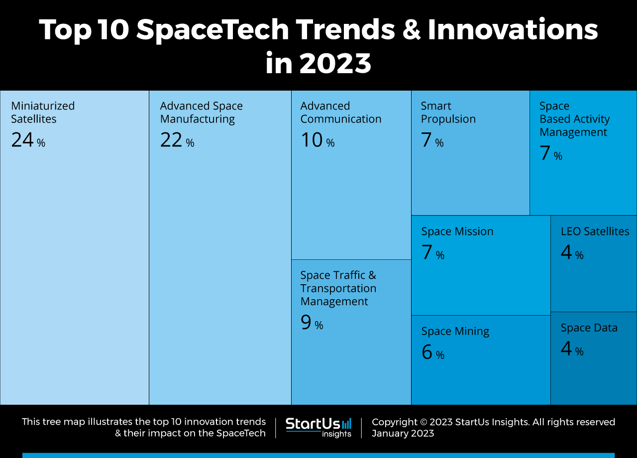
Priority areas of applications
Target areas of applications:
Small Satellites for Telecoms
Small Satellites for Earth Observation
In Jan 2024, 8377 were orbiting the Earth.
Of these, 84% in LEO.
  3135 for Communications
  1052 for Earth Observation
  383 for technology development
  154 for navigation
  108 for space science
80% of communication satellites are small satellites (i.e., mass<300 kg).
Overall, 72% of active satellites are small satellites.

Slide 21
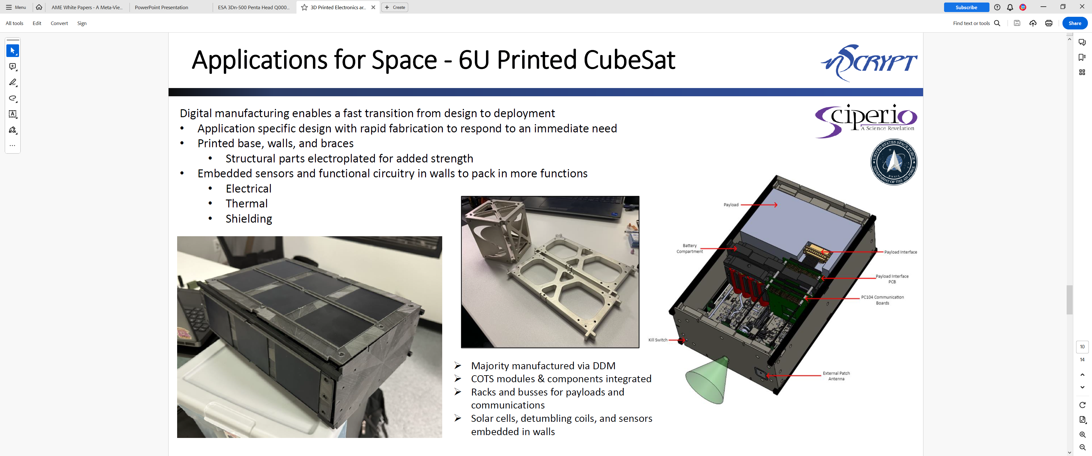
Priority areas of applications – Small Satellites
Intelligent management of space is crucial for small satellites to house payloads while being as economical with size as possible.
Constellation operators replace each deorbiting satellite within years with new designs based on the latest technologies to introduce new capabilities, which provides the perfect opportunity to experiment with novel AM technologies for electronics.
Credit Nano Dimension
Higher density, weight/volume optimization, and more space available inside the satellite
Possibility to print locally, on-demand, and quickly adapt to market needs

Slide 22
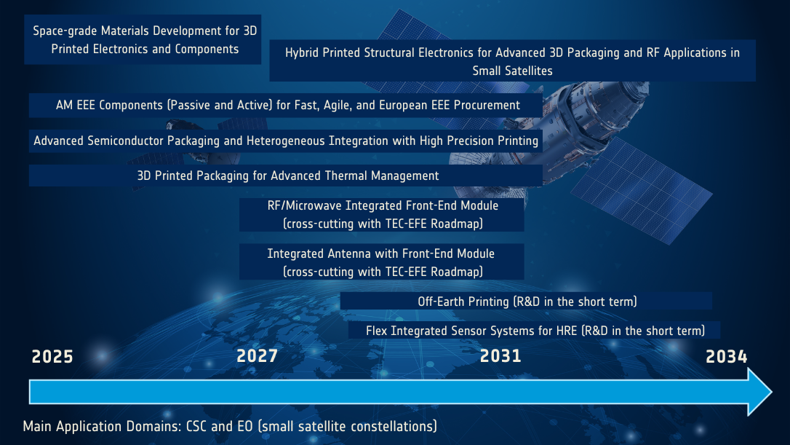
AME ROADMAP

Slide 23
OUTLINE
Intro to AME
ESA Vision for AME
Technology Gaps
Roadmap
GSTP Compendium
Conclusions
01
04
02
05
03
06

Slide 24
RUNNING AND RECOMMENDED AME ACTIVITIES

Slide 25
AME GSTP COMPENDIUM DRAFT
HYBRID STRUCTURAL ELECTRONICS AND AM EEE COMPONENTS
Space-grade Materials Development Suitable for 3D Printing of Electronics and Components
Hybrid Printed Structural Electronics for Advanced 3D Packaging and RF Applications in Small Satellites
Advanced Manufactured Passive EEE Components for LEO Satellites
Advanced Manufactured Active EEE Components for LEO Satellites
Advanced Manufacturing of 3D Printed Pseudocapacitive Electrodes for Supercapacitors (shared with ESCC CTB Passive WG roadmap)
3D Printed and Custom-design Multilayer Ceramic Capacitors (shared with ESCC CTB Passive WG roadmap)
ADVANCED PACKAGING
Advanced Wafer-Level Packaging with High-Precision Printing for Space Applications
Advanced Manufactured Packaging Solutions for Advanced Thermal Management in Space Applications

Slide 26
OUTLINE
Intro to AME
ESA Vision for AME
Technology Gaps
Roadmap
GSTP Compendium
Conclusions
01
04
02
05
03
06

Slide 27
CONCLUSIONS
Advanced Manufacturing for Electronics (AME), such as printing and additive manufacturing, has the potential to revolutionize EEE components and electronics development and disrupt the future of space industry.
The high-variety low-volume space industry particularly benefits from the advantages of AME.
Accelerated procurement time, independent European supply chain, sustainability, low costs and miniaturization are among the main motivations for AME adoption.
Areas of application of high interest include small satellites for telecommunications and earth observation.
TEC-ED (in collaboration with TEC-MSP) is introducing a long-term roadmap to support and facilitate the industrialization of AME technologies.
Activities to accelerate AME development and adoption in space are being proposed in a GSTP Compendium.
Organizations are welcome to spontaneously submit innovative proposals through the OSIP platform
Organizations are invited to register on esa-star and monitor the platform for relevant Invitations To Tender.

Slide 28

ESA AME WORKSHOP ON AME

Slide 29
Thank you for your attention!
For any questions or information, contact me at Rita.Palumbo@esa.int
Dr Rita Palumbo
5th SPACE PASSIVE COMPONENT DAYS - SPCD 2024
ESA ECSAT TEC-ED
17/10/2024

